Slide 1
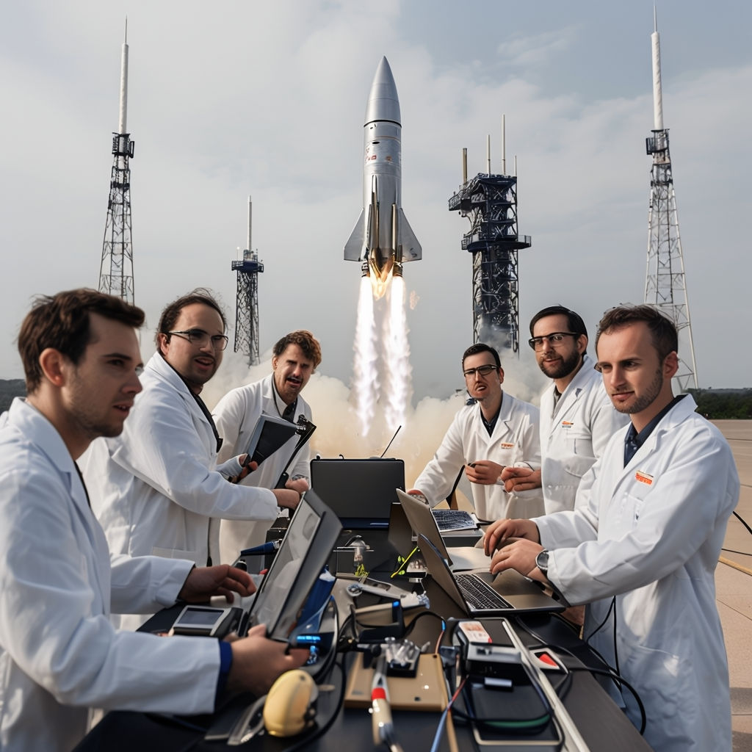
Scientific Investigations
INVESTIGATING SCIENCE MODULE 5

Slide 2
5.1
5.1: What initiates an investigation?
research the factors that led scientists to investigate the following, including but not limited to:
peptic ulcers (Marshall and Warren)
plant growth (Von Helmont)
microwaves (Spencer)
propose a reason for the scientists undertaking their investigations above by examining the type of data or information that they sought, for example:
finding relationships or patterns in identified phenomena
testing the conclusion of a previous investigation
utilising scientific knowledge and understanding to make more accurate predictions and develop new technologies
determine the hypotheses that were tested in each of the scientific investigations above
describe where deviations from the traditional and linear models of scientific methodology were necessary in order to test each hypothesis in the investigations above

Slide 3
5.1.1
5.1.1 research the factors that led scientists to investigate the following, including but not limited to:
5.1.1.1 peptic ulcers (Marshall and Warren)
5.1.1.2 plant growth (Von Helmont)
5.1.1.3 microwaves (Spencer)

Slide 4


5.1.1 – Why did they investigate that?
What are some reasons as to why someone would start a scientific investigation?
Think of this through the perspective of:
Yourself
A random scientist
Your choice of a particular scientist (we’ll do this for Marshall and Warren, Von Helmont, and Spencer too)

Slide 5
5.1.1 – Why did they investigate that?
There are many factors that can initiate investigations. Some of these include:
Looking for or understanding more relationships and or patterns between variables.
Testing others’ conclusions and hypothesis.
New technologies and innovations that can measure more acutely and with more precision.
The quest of discovery, to find what is not known.

Slide 6
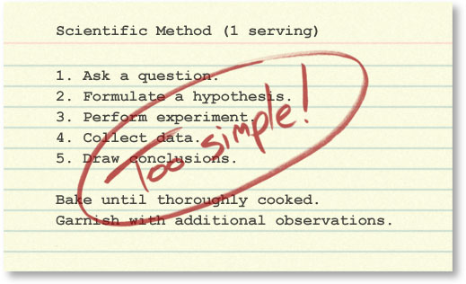

Slide 7

5.1.1 – The Real Scientific Method
The simplified, linear scientific method implies that science has little room for creativity. In reality, the process of science is exciting, dynamic, and unpredictable. Science relies on creative people thinking outside the box.
The simplified, linear scientific method implies that science concludes. In reality, scientific conclusions are always revisable if warranted by the evidence. Scientific investigations are often ongoing, raising new questions even as old ones are answered.

Slide 8
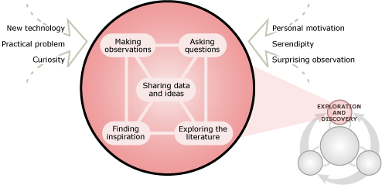
5.1.1 – The Real Scientific Method
Scientists often begin an investigation by plain old poking around; tinkering, brainstorming, trying to make some new observations, chatting with colleagues about an idea, or doing some reading.

Slide 9
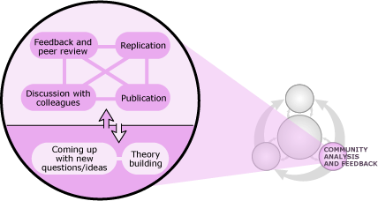
5.1.1 – The Real Scientific Method

Slide 10

5.1.1 – The Real Scientific Method
Watch 5.1.1 – How Science Works

Slide 11
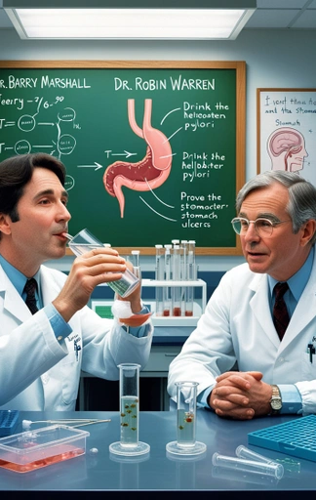
5.1.1.1 – Marshall and Warren & Peptic Ulcers
What’s a peptic ulcer?
Peptic ≈ digestion, which is in the stomach
Peptic ulcer = stomach ulcer
What’s a stomach ulcer?

Slide 12
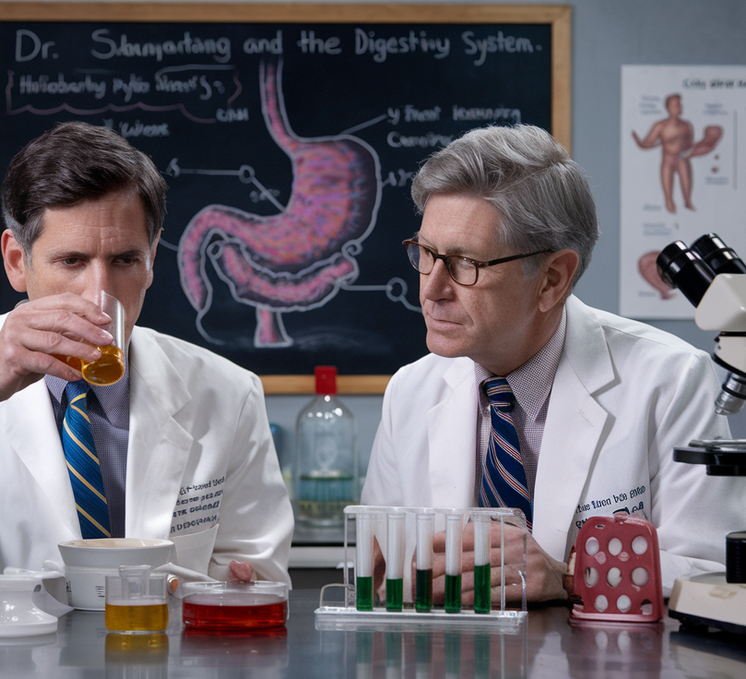
Watch 5.1.1.1 – The Man Who Tried to Give Himself an Ulcer for Science (4 min)

Slide 13

5.1.1.1 – Marshall and Warren & Peptic Ulcers
What initiated the investigation into peptic ulcers?
What was initially thought to cause ulcers?
How did the scientist aim to test the ideas you wrote about in question 2?
What was tested and how was it tested?
What where some outcomes in terms of development of new ideas and technologies, of this investigation into peptic ulcers?

Slide 14
Marshall and Warren
This is a past paper question from the 2019 HSC
Use your knowledge of Marshall and Warren’s investigations to answer these questions.

Slide 15
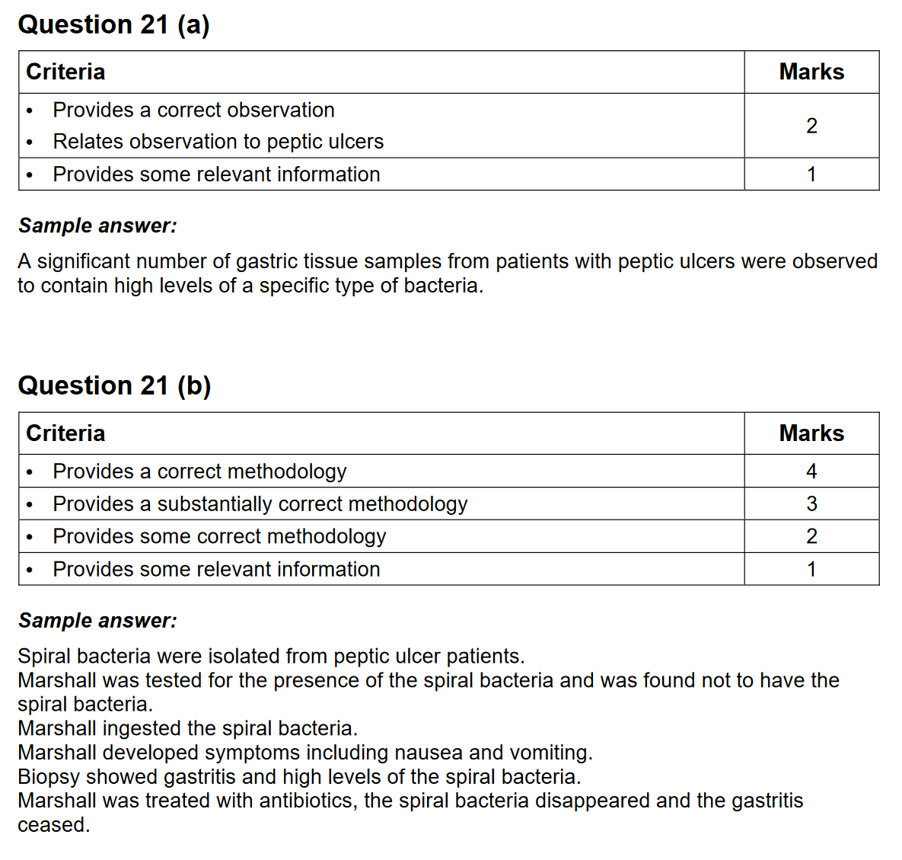

Slide 16
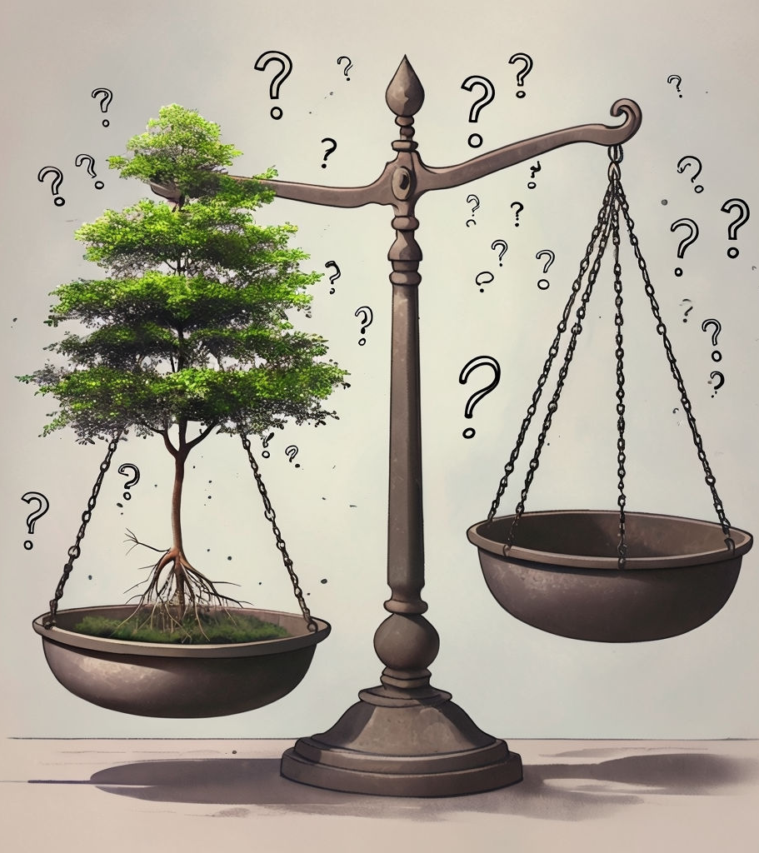
5.1.1.2 – Van Helmont
Before we follow Jan Baptist van Helmont on his journey, let’s survey the class:
Where do trees get their mass?

Slide 17
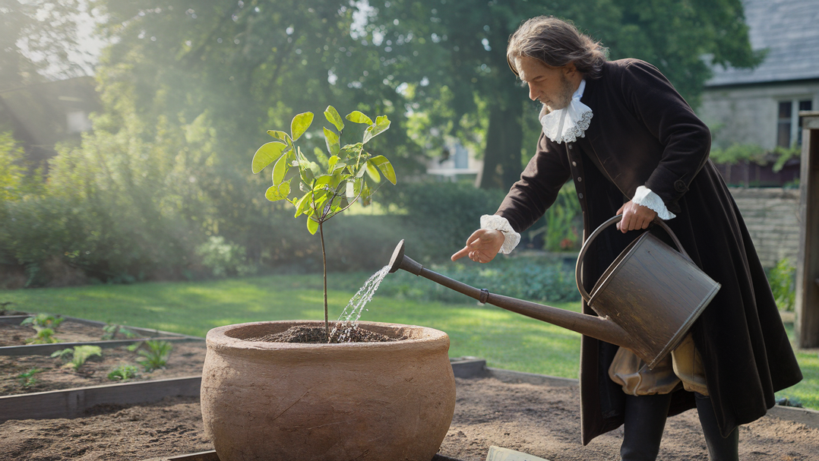
5.1.1.2 – Van Helmont
van Helmont was pretty sure plants gained mass by extracting nutrients from the soil they were placed in.
He set out to gain evidence for his hypothesis.
Watch 5.1.1.2 – Where Do Trees Get Their Mass (4 min)

Slide 18
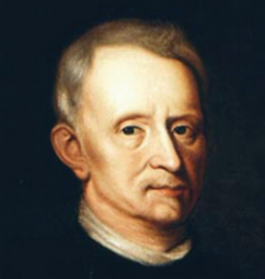
5.1.1.2 – Van Helmont (Factors)
In the early 1600’s, Jan Baptist van Helmont, a Belgian doctor and chemist, was an early researcher into the way gases moved and interacted. He is credited with the first use of the term gas.
He was also curious about how plants grew from seemingly nothing. He took a young willow seedling, put it in a pot with soil and let it grow. All he did was add water. Then he took careful measurements of the mass of the soil and willow plant.
Later, other researchers determined that this small loss of soil was significant, as elements found in the soil such as sulphur, nitrogen, potassium, phosphates and nitrates were essential for the healthy growth of the plants. The plant extracted these elements in small amounts from the soil.

Slide 19
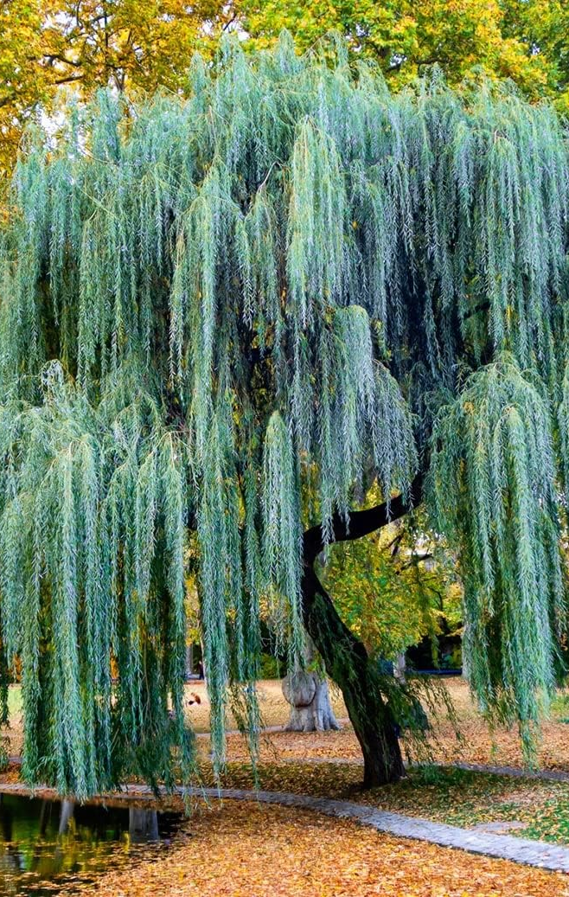
5.1.1.2 – Van Helmont (Patterns)
Van Helmont tried to establish relationships between the variables that he was managing. At the end of the experiment, he dried the soil and weighed it but did not observe a significant change. However, the tree was 76 kilograms heavier. As he used only one plant, it was difficult for him to establish any patterns or relationships.
The process of photosynthesis had not yet been described; therefore, he did not know that atmospheric gases were playing a key role in the willow tree’s weight gain.

Slide 20
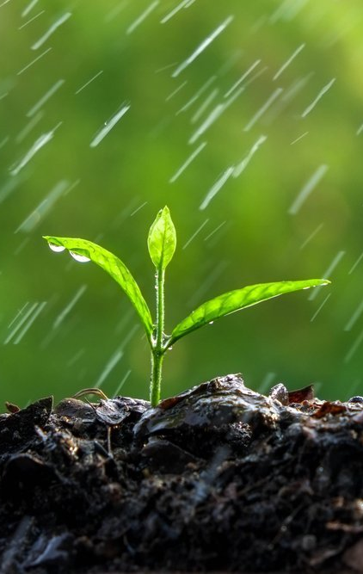
5.1.1.2 – Van Helmont (Patterns)
van Helmont had worked with carbon dioxide (he called it ‘gas sylvestre’), it would be 100 years before gas exchange was discovered.
As a result, this made it hard for van Helmont to ascertain the correct relationship between the loss of mass in the soil, the addition of water and the growth of plants.

Slide 21
5.1.1.2 – Van Helmont
What was Van Helmont trying to demonstrate with his investigation?
How did he try to determine the answer to his questions?
What, if anything did van Helmont fail to do?
What new ideas came about after his experiment?

Slide 22
5.1.1.2 – Van Helmont
This is a past paper question from the 2019 HSC
Use your knowledge of van Helmont’s investigations to answer this question.

Slide 23
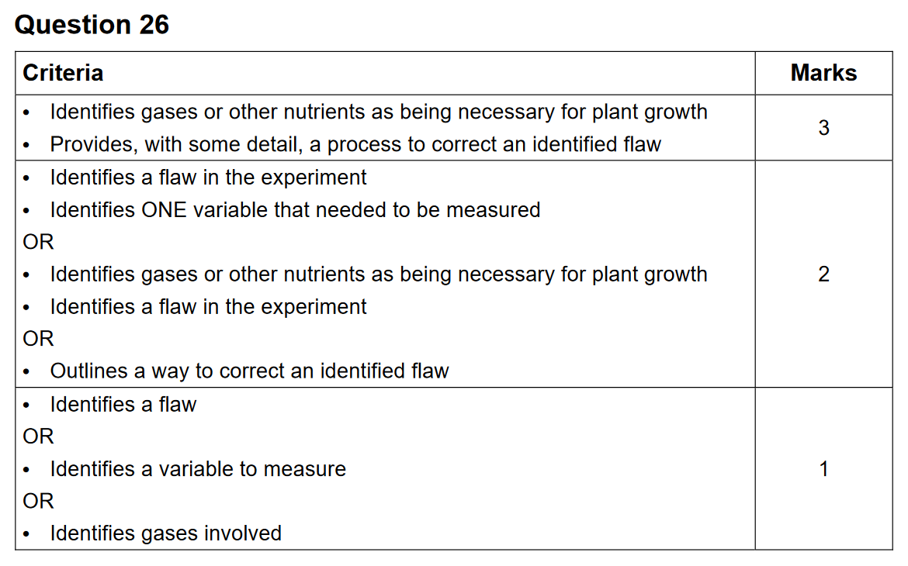

Slide 24
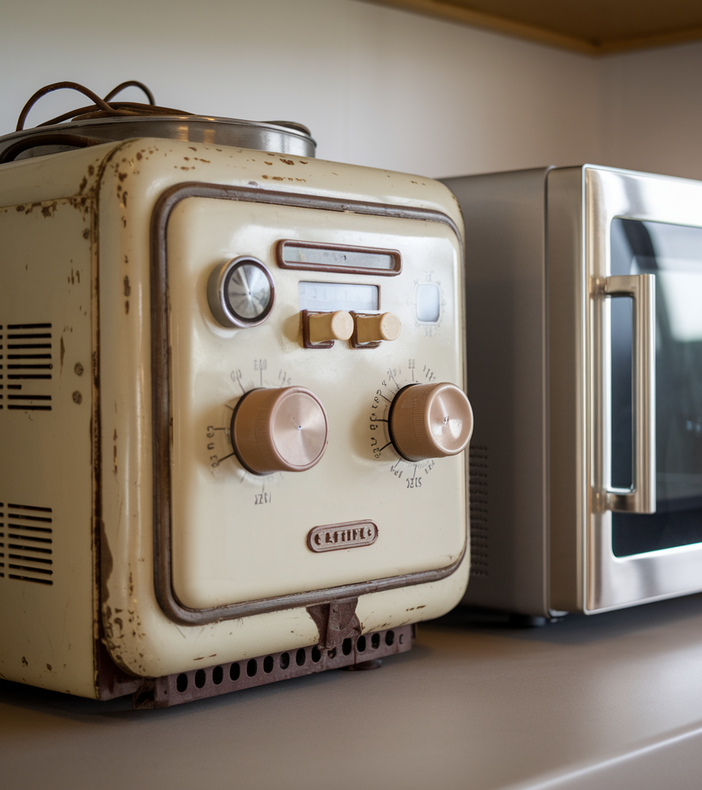
5.1.1.3 – Spencer
Percy Spencer invented microwaves, but this was not his intention.
He didn’t have this as his experimental aim.
He didn’t write a method with discovering microwave ovens in mind.
It was an accident. Like lots of scientific discoveries.

Slide 25
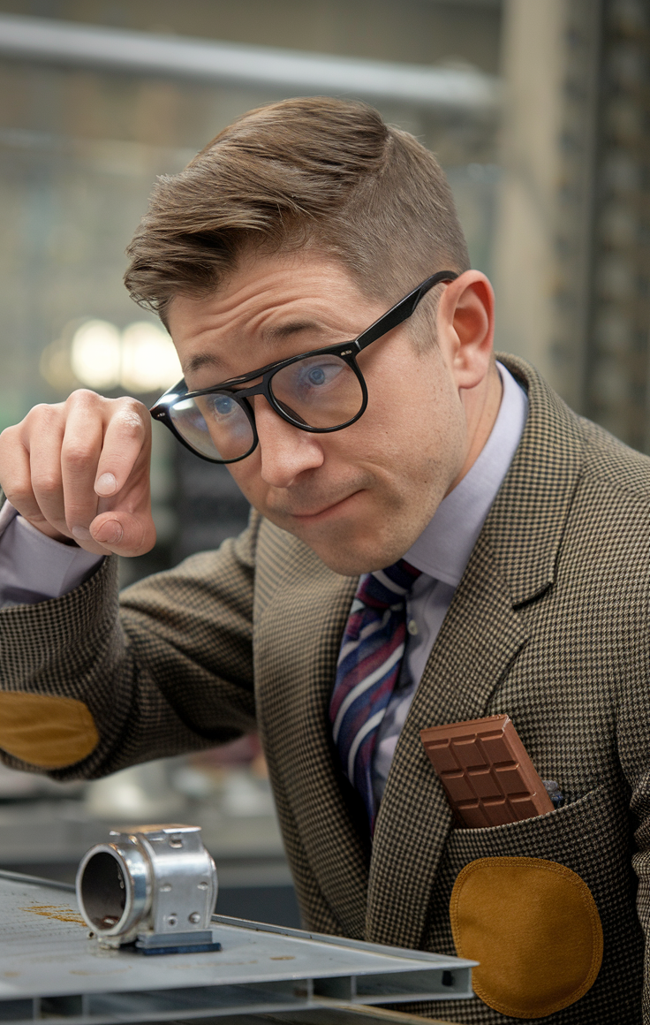
5.1.1.3 – Spencer
Watch 5.1.1.3 – Microwave Oven – Accidental Inventions (6 min)

Slide 26
5.1.1.3 – Spencer
What factors led to the discovery of microwave oven?
What experiments were conducted to draw a valid conclusion from initial observations mentioned above?
What new technologies and ideas came about after this investigation?

Slide 27
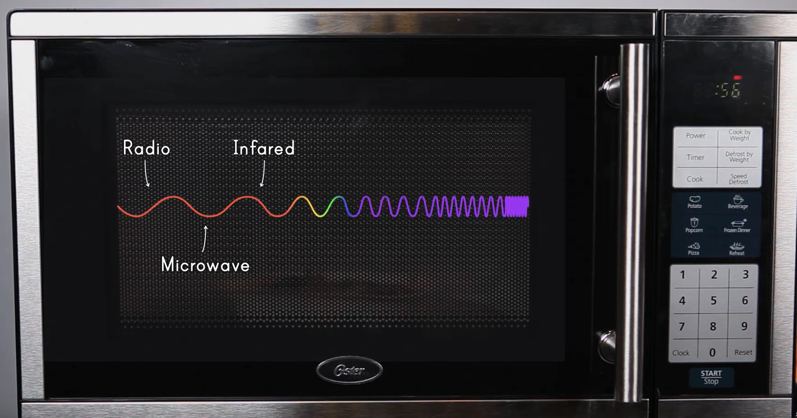
5.1.1.3 – Microwaves & the Speed of Light
Watch 5.1.1.3 – How To Calculate The Speed Of Light With Your Microwave (4 min, but stop @ 2:45 to avoid spoilers)

Slide 28

5.1.1.3 – Microwaves & the Speed of Light
Use the previous video to support you in writing a full method for calculating the speed of light using a microwave.
Include:
Aim (To investigate…; To calculate…; To …)
Hypothesis (If _______, then _______, because _________)
Variables (independent, dependent, controlled [minimum 3])
Materials (dot points, diagrams, amounts, sizes)
Method (dot points, chronological order)
Risk Assessment (RIP table)
Results (table ready for data entry)

Slide 29
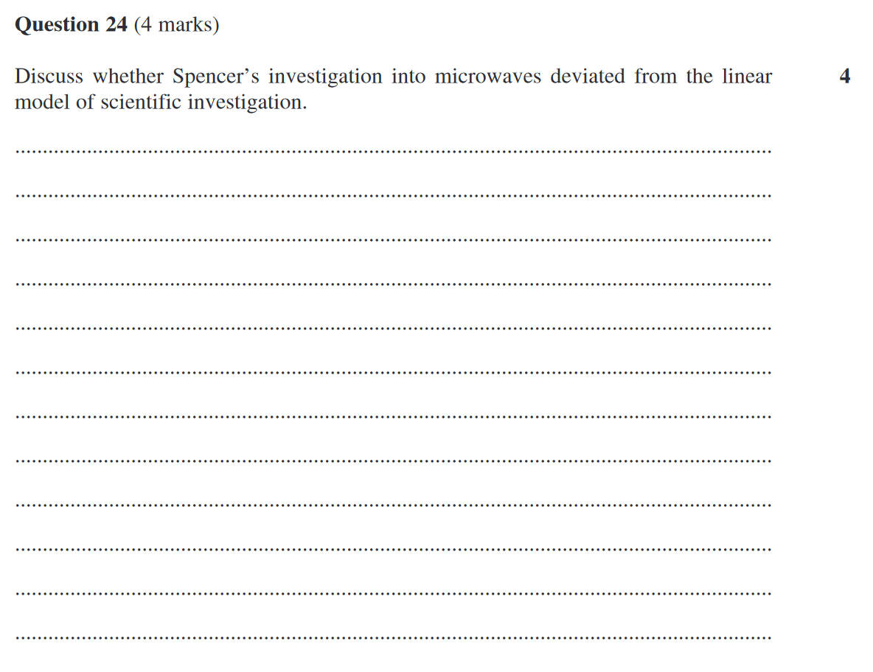
5.1.1.3 & 5.1.4
This is a past paper question from the 2021 HSC
Use your knowledge of Percy Spencer’s investigation to answer this question.

Slide 30
5.2
5.2: What type of methodology best suits a scientific investigation?
using examples, evaluate the objectives and data collected in an investigation by a recognised scientist or team of scientists, including but not limited to:
Marshall and Warren and peptic ulcers
Eratosthenes and Earth’s circumference
Doppler and the Doppler effect
Priestley’s experiments with oxygen
evaluate the methodology of the scientific investigations above by:
justifying the method chosen based on the subject of the investigation and the context, for example: experimental testing, fieldwork, locating and using information sources, conducting surveys and using modelling and simulations
evaluating the relevance of the investigation by considering the peer-reviewed literature in the area of study
justifying the suitability of the type of data that is to be collected
develop a method most appropriate to test a hypothesis following observation
justify the type of methodology used to test the hypothesis

Slide 31
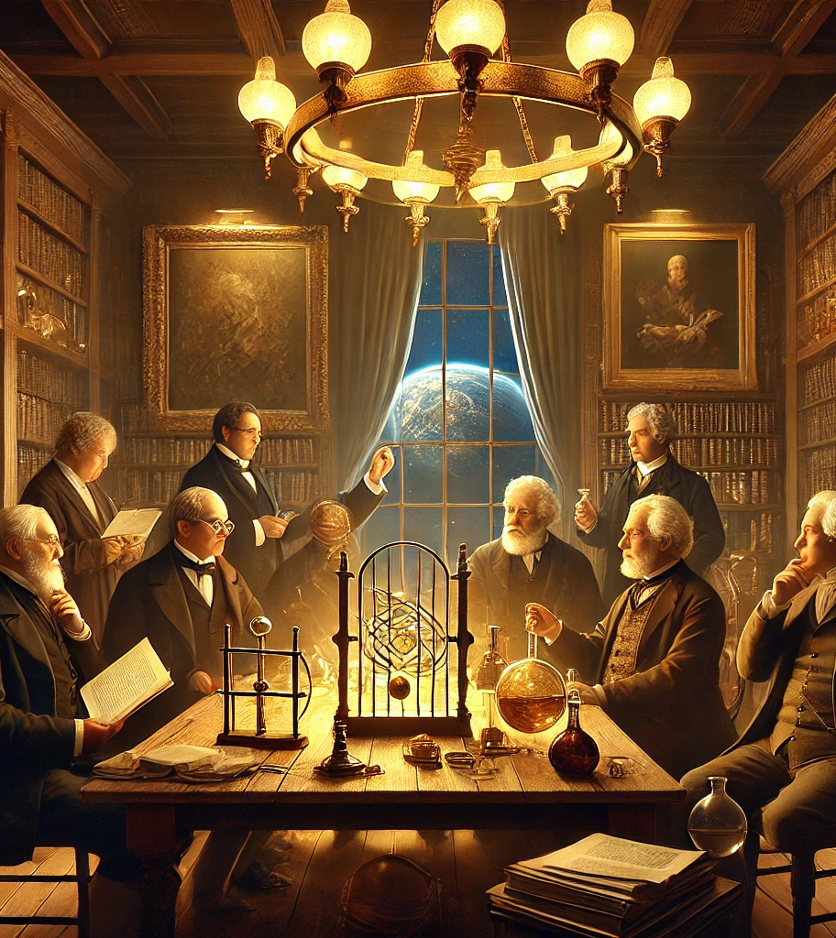
5.2.1
Using examples, evaluate the objectives and data collected in an investigation by a recognised scientist or team of scientists, including but not limited to:
Marshall and Warren and peptic ulcers
Eratosthenes and Earth’s circumference
Doppler and the Doppler effect
Priestley’s experiments with oxygen

Slide 32

5.2.1/2.1 – Marshall and Warren and peptic ulcers
Evaluate the objectives and data collected
Evaluate the methodology
Done above in 5.1

Slide 33
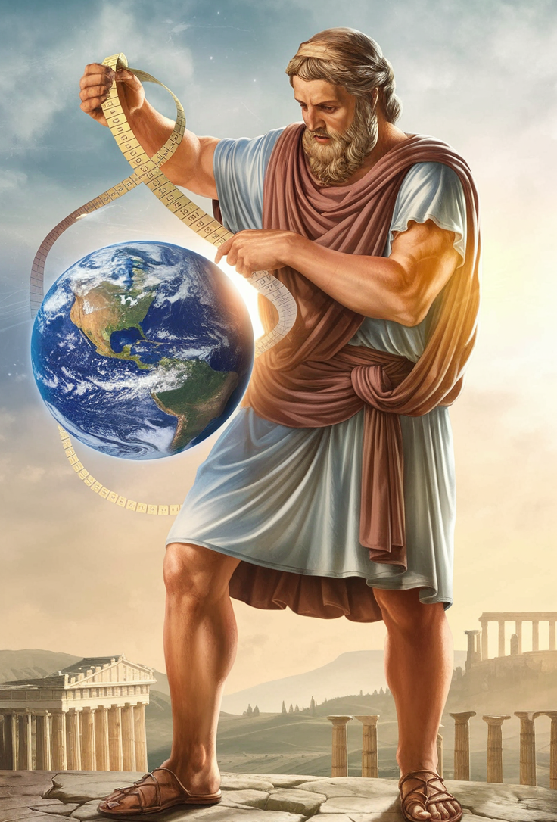
5.2.1.2 – Eratosthenes and Earth’s circumference
Evaluate the objectives and data collected
Evaluate the methodology
Watch 5.2.1.2 – Carl Sagan – Cosmos – Eratosthenes
Watch 5.2.1.2 – How Eratosthenes calculated the Earth's circumference

Slide 34
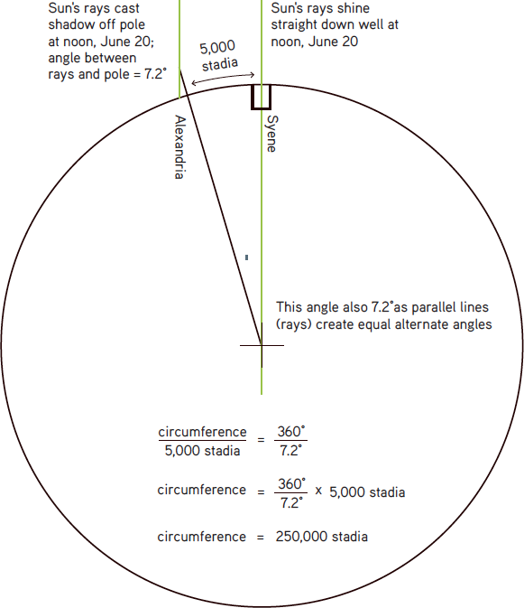
5.2.1.2 – Eratosthenes
Eratosthenes could measure the angle of the Sun’s rays off the vertical by dividing the length of the leg opposite the angle (the length of the shadow) by the leg adjacent to the angle (the height of the pole). This gave him an angle of 7.12 degrees.
He knew that the circumference of Earth constituted a circle of 360 degrees, so 7.12 (or 7.2, to divide 360 evenly by 50) degrees would be about one-fiftieth of the circumference.
He also knew the approximate distance between Alexandria and Syene was 5000 stadia. We don’t use stadia today. The distance was about 800 km so that could be placed in the equation to get 40,000 km.
The actual distance is 40,075 km.
How did the data collected help him solve the problem of the Earths circumference?

Slide 35
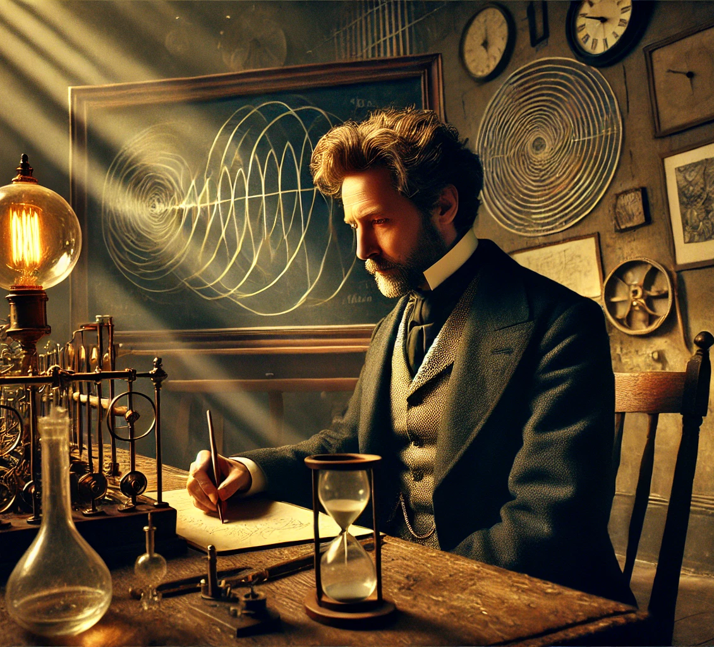
5.2.1.3 – Doppler and the Doppler effect
Evaluate the objectives and data collected
Evaluate the methodology

Slide 36

5.2.1.3 – Doppler
His earliest work concerned mathematics, but in 1842 Doppler completed and published the paper On the Coloured Light of Double Stars and Certain Other Stars of the Heavens.
Within the work, he proposed that observed frequency of light and sound waves is dependent upon how fast the source and observer are moving relative to each other, a phenomenon commonly referred to as the Doppler effect.
He also correctly predicted that his theory would someday be utilized by astronomers to more accurately measure the movements and distances of stars.

Slide 37
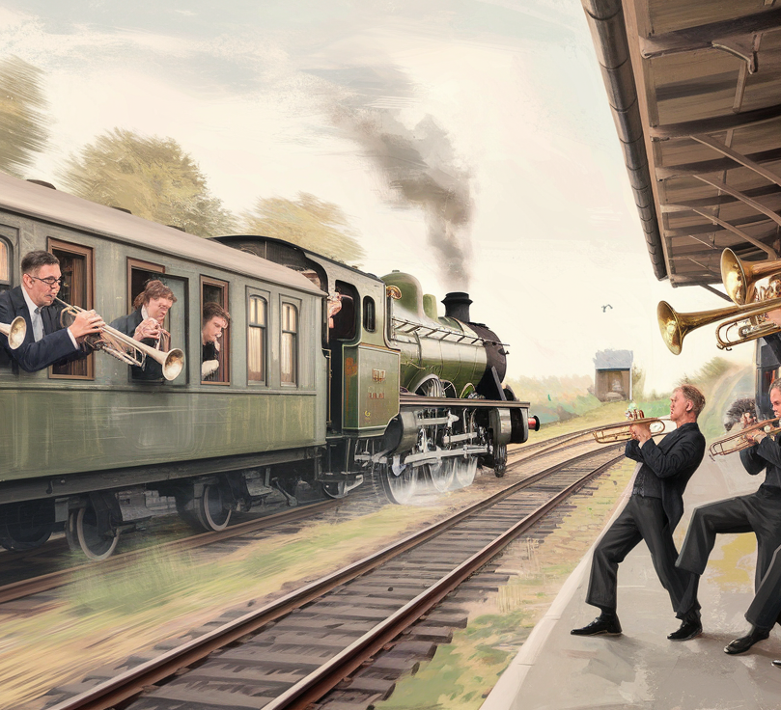
5.2.1.3 – Doppler
Doppler's ideas were initially received with a certain amount of scepticism so; to support his claims, he devised an extremely unusual experiment. In 1845, with the help of a colleague, Doppler arranged for a train to carry an open car full of trumpeters back and forth along a section of track.
Alongside, another group of musicians stood by and recorded their perceptions of the pitch of the instruments. The innovative test proved successful, confirming Doppler's prediction that as the trumpets approached the musicians heard a higher pitch, which became noticeably lower as the train passed by.

Slide 38
5.2.1.3 – Doppler Effect
Demonstrating that the Doppler effect also held true for the frequency of light proved more difficult and was never successfully achieved before Doppler's death in 1853.
The first experiment that revealed a Doppler shift in starlight was carried out at the beginning of the twentieth century. Since that time, however, the Doppler effect has proven invaluable for astronomical observations, paving the way for a host of new scientific discoveries and concepts.
Most notably, the motions of stars detected through this manner led to the development of the big bang theory of the universe.

Slide 39


5.2.1.3 – Doppler Effect
Watch 5.2.1.3 – Doppler effect using trumpet
Watch 5.2.1.3 – Doppler Effect
Watch 5.2.1.3 – The Doppler Effect – What does motion do to waves
What method did Doppler use to demonstrate his hypothesis?
How effective was the data gathered at supporting his hypothesis?

Slide 40
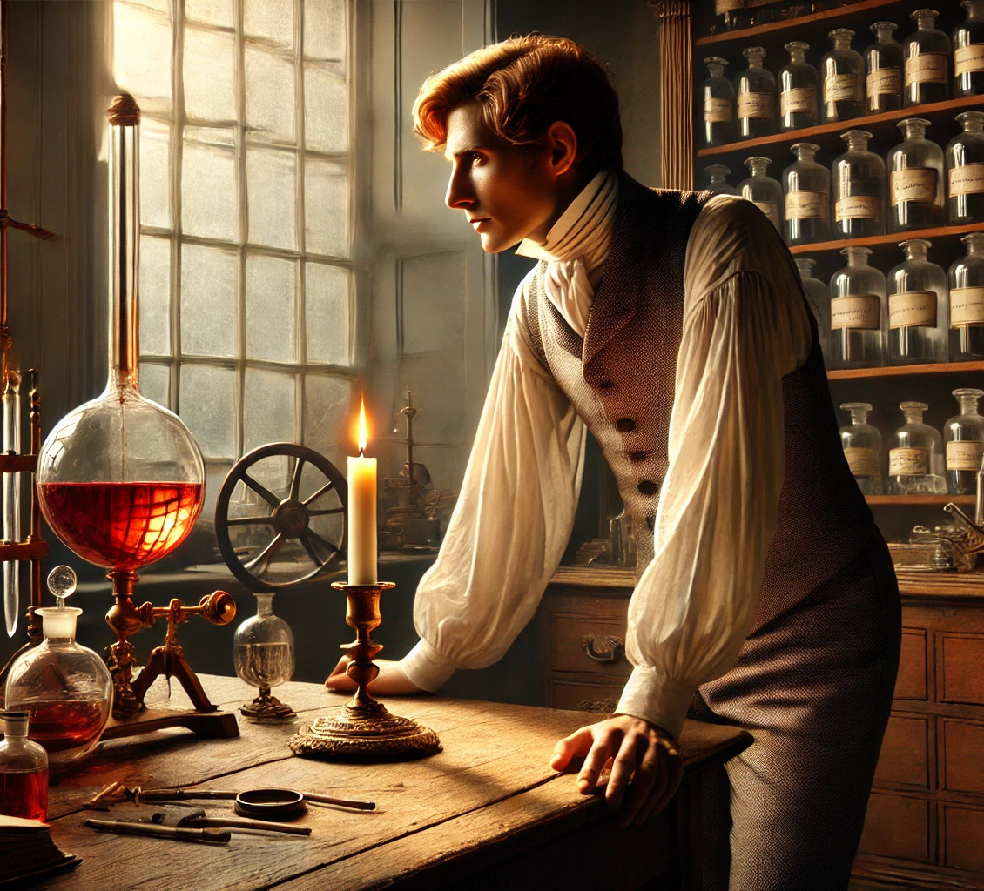
5.2.1.4 – Priestley’s experiments with oxygen
Evaluate the objectives and data collected
Evaluate the methodology

Slide 41
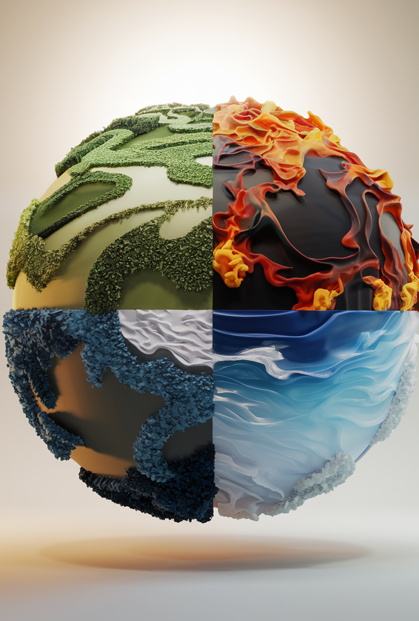
5.2.1.4 – Priestley’s and oxygen
Some 2,500 years ago, the ancient Greeks identified air — along with earth, fire and water — as one of the four elemental components of creation.
That notion may seem charmingly primitive now. But it made excellent sense at the time, and there was so little reason to dispute it that the idea persisted until the late 18th century.
It might have endured even longer had it not been for a free-thinking English chemist and maverick theologian named Joseph Priestley.

Slide 42
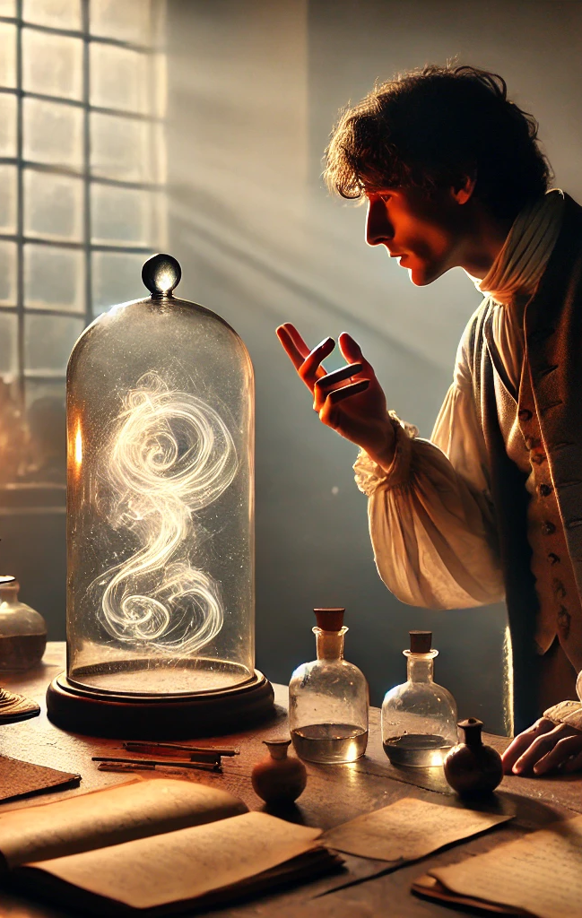
5.2.1.4 – Priestley and oxygen
The world recalls Priestley best as the man who discovered oxygen, the active ingredient in our planet's atmosphere. In the process, he helped de-throne an idea that dominated science for 23 uninterrupted centuries: Few concepts “have laid firmer hold upon the mind”, he wrote, than that air “is a simple elementary substance, indestructible and unalterable”.
In a series of experiments culminating in 1774, Priestley found that “air is not an elementary substance, but a composition”, or mixture of gases. Among them was the colourless and highly reactive gas he called “dephlogisticated air”, to which the great French chemist Antoine Lavoisier would soon give the name “oxygen”.

Slide 43
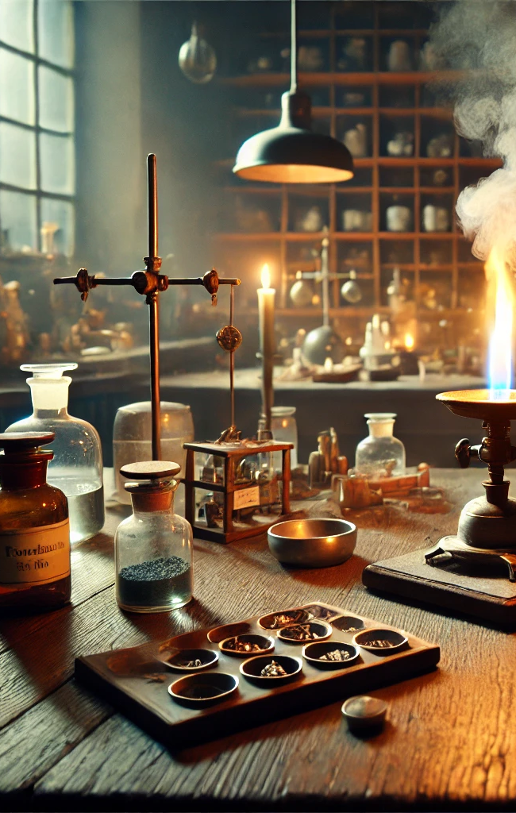
5.2.1.4 – Priestley and oxygen
In the mid-18th century, the concept of an element was still evolving. Researchers had distinguished no more than two dozen or so elements, depending on who was doing the counting. It wasn't clear how air fit into that system. Nobody knew what it was, and researchers kept finding that it could be converted into such a variety of forms that they routinely spoke of different “airs”.
The principal method for altering the nature of air, early chemists learned, was to heat or burn some compound in it.

Slide 44
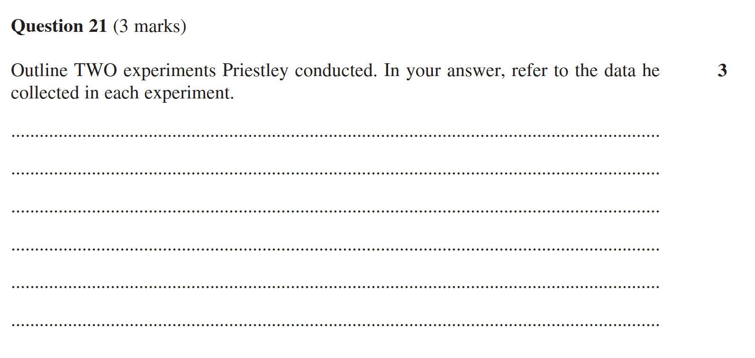
5.2.1.4 – Priestley and oxygen – 2020

Slide 45
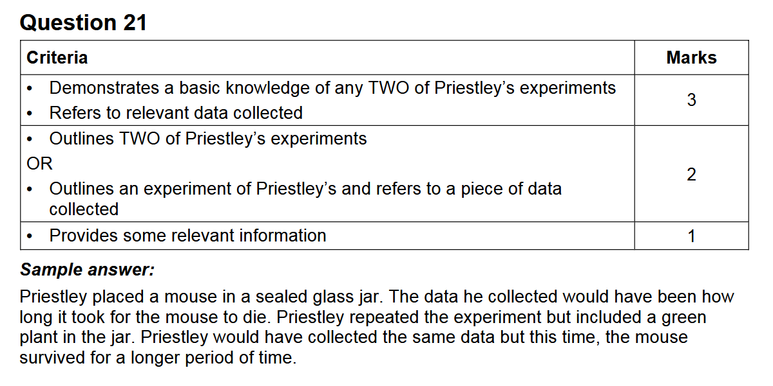
5.2.1.4 – Priestley and oxygen – 2020

Slide 46
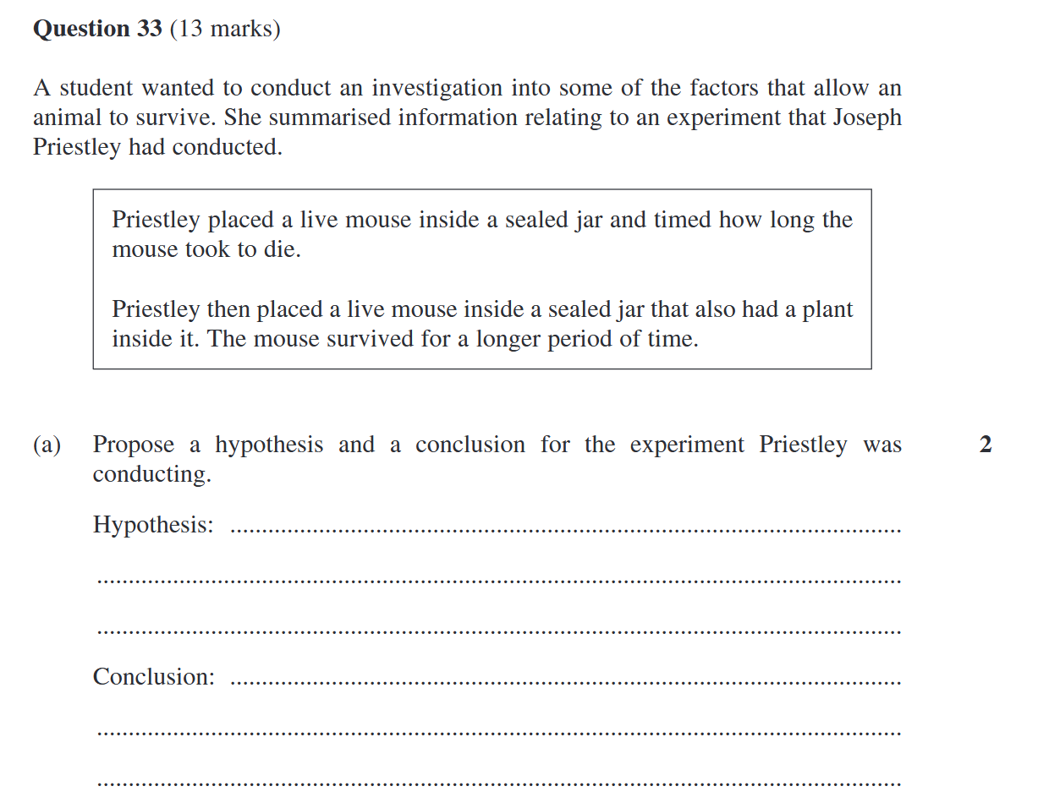
5.2.1.4 – Priestley 2021

Slide 47
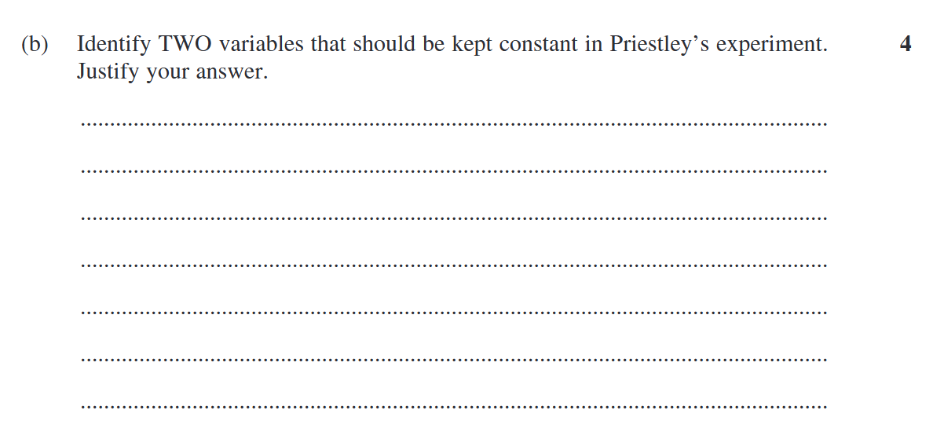
5.2.1.4 – Priestley 2021

Slide 48
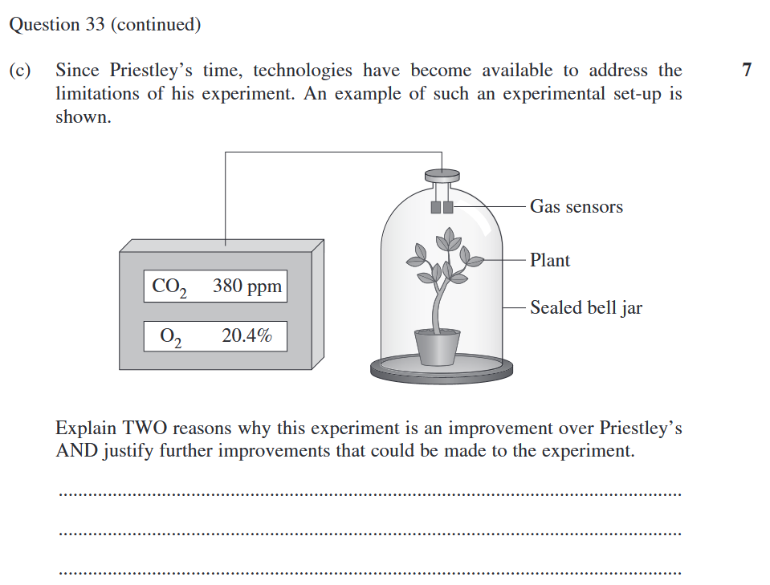
5.2.1.4 – Priestley 2021

Slide 49
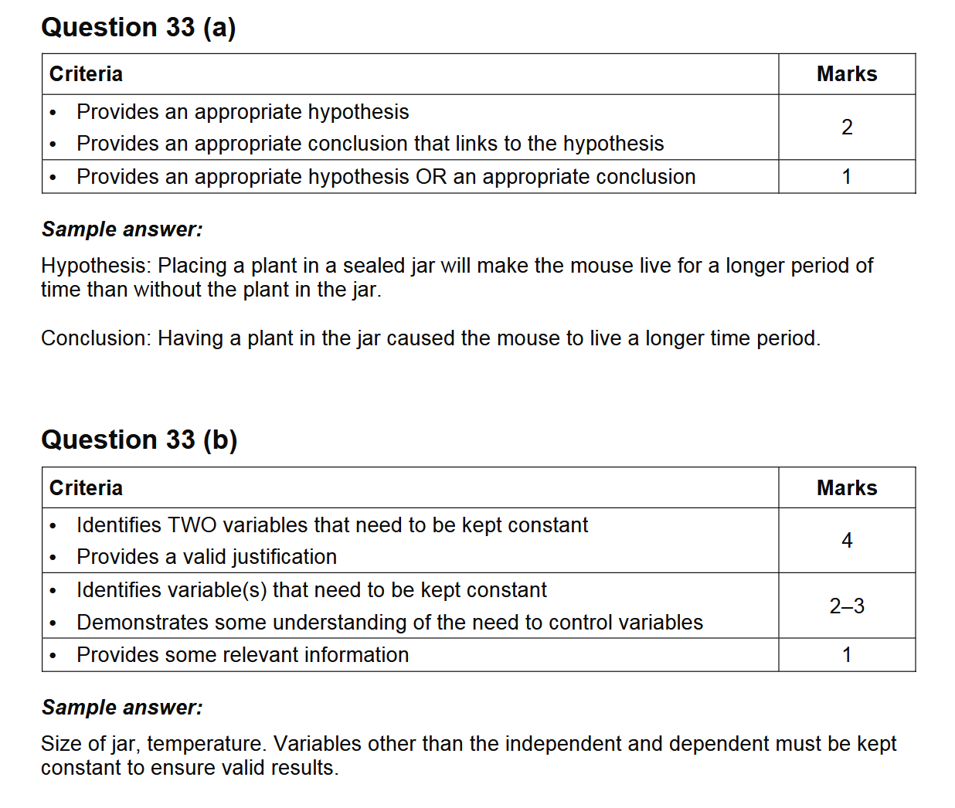
5.2.1.4 – Priestly 2021 – MG

Slide 50
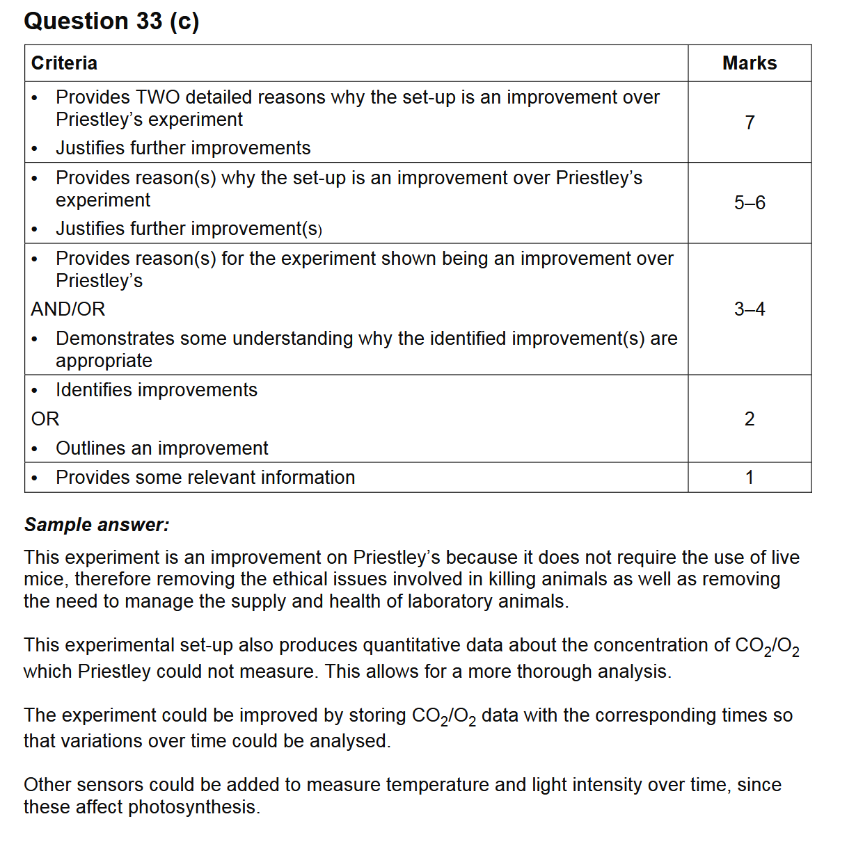
5.2.1.4 – Priestly 2021 – MG

Slide 51

5.2.3 & 5.2.4 – Design Your Own Experiment
Develop a method most appropriate to test a hypothesis following an observation
Justify the type of methodology used to test the hypothesis

Slide 52
5.3
5.3: How is the integrity of a scientific investigation judged?
evaluate the design of the student investigation by:
explaining the choice of independent, dependent and controlled variables with reference to the research question
explaining the sample selection and sample sizes used for gathering data
justifying the suitability of materials used based on their relevance to the research question, availability, cost, risk and familiarity of use
assessing the ethics of conducting the investigation by considering confidentiality, humane treatment and animal welfare
predicting an achievable time frame to conduct the investigation
justifying working individually or collaboratively
conduct the planned investigation and collect, record and analyse primary data
draw a conclusion or conclusions, and suggest further investigation or research by:
analysing the results and interpreting the data
explaining the relevance of the findings of the investigation in relation to the inquiry question and hypothesis
justifying the methodology and any changes made to improve the data collected
describing potential beneficial and harmful consequences when the findings are applied to a real-world scenario
evaluate the validity of the investigation by determining whether the tests measured what they were intended to measure
evaluate the reliability of the investigation by determining:
consistency of the results obtained
measures taken to reduce error

Slide 53

5.3 – Design Your Own Experiment
Explain the choice of independent, dependent and controlled variables with reference to the research question
Explaining the sample selection and sample sizes used for gathering data
Justify the suitability of materials used based on their relevance to the research question, availability, cost, risk and familiarity of use
Assess the ethics of conducting the investigation by considering confidentiality, humane treatment and animal welfare
Predicting an achievable time frame to conduct the investigation
Justify working individually or collaboratively
Conduct the planned investigation and collect, record and analyse primary data
Draw a conclusion or conclusions, and suggest further investigation or research by:
Analysing the results and interpreting the data
Explaining the relevance of the findings of the investigation in relation to the inquiry question and hypothesis
Justifying the methodology and any changes made to improve the data collected
Describing potential beneficial and harmful consequences when the findings are applied to a real-world scenario
Evaluate the validity of the investigation by determining whether the tests measured what they were intended to measure
Evaluate the reliability of the investigation by determining:
Consistency of the results obtained
Measures taken to reduce error

Slide 54
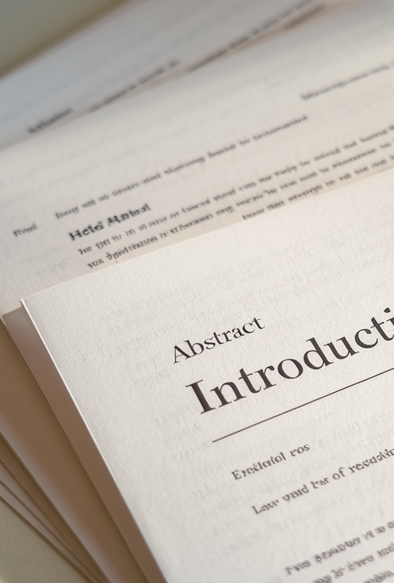
5.4 – Structure of a Research Paper
review a published and peer-reviewed scientific report to determine the conventions of writing a report on a practical investigation
use a sample of a published and peer-reviewed secondary source to identify:
the purpose of the report
measures taken to reduce error
the language style used
the presentation and structure of the report
compare and contrast the structures and functions of a scientific investigation and its written report
prepare a report on the student investigation that was carried out

